Slide 1
Optimization Using Method of Exhaustive Search, Greedy Search and MATLAB’s solver
A report by John Michael Corbeta

Slide 2
Integer Linear Programming
Is a mathematical optimization or feasibility program in which some or all of the variables are restricted to be integers.
Integer programming is NP-complete. In particular, the special case of 0-1 integer linear programming, in which unknowns are binary, and only the restrictions must be satisfied, is one of Karp's 21 NP-complete problems.

Slide 3
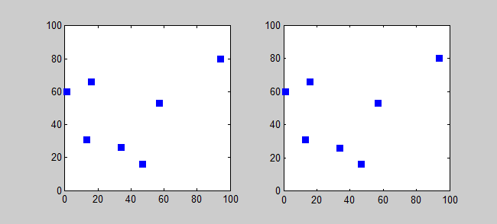
Exhaustive/Brute Search
Is also known as generate and test, is a very general problem-solving technique and algorithmic paradigm that consists of systematically enumerating all possible candidates for the solution and checking whether each candidate satisfies the problem's statement.

Slide 4
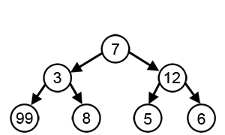
Greedy Algorithm
is a simple, intuitive algorithm that is used in optimization problems. The algorithm makes the optimal choice at each step as it attempts to find the overall optimal way to solve the entire problem. Greedy algorithms are quite successful in some problems, such as Huffman encoding which is used to compress data, or Dijkstra's algorithm, which is used to find the shortest path through a graph.

Slide 5
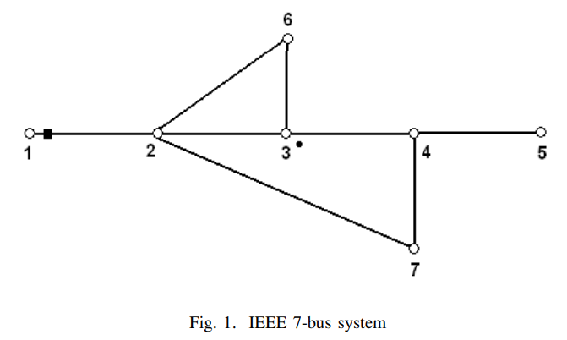
Optimal PMU Placement

Slide 6
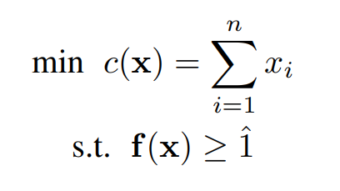
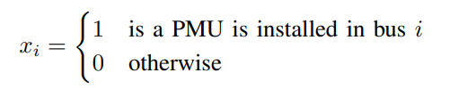
Model Formulation

Slide 7
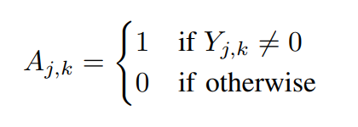
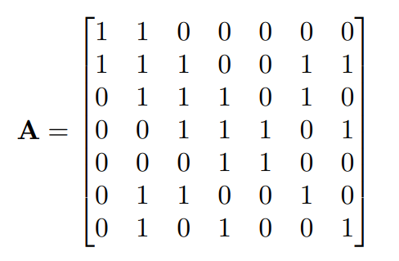
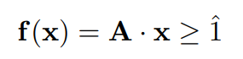
Constraints Formulation

Slide 8
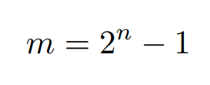
Exhaustive/Brute Search
For an OPP problem of an n bus system, with each x_{i} having the two possible value as described below, the number of possible solution is as follows:

Slide 9
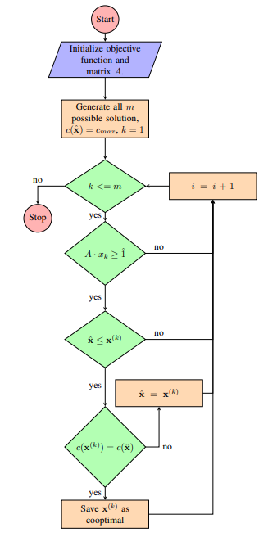
Exhaustive Search
Flowchart

Slide 10
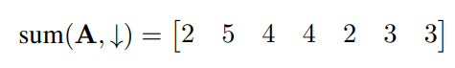
Greedy Algorithm
For the first stage, the sum of the elements of the column is the number of constraints covered by each variable given by

Slide 11
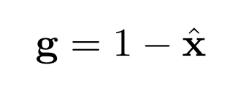
Greedy Algorithm
This time we need to create a filter vector to multiply to the rows A matrix. This filter vector g can be derived as follows:

Slide 12
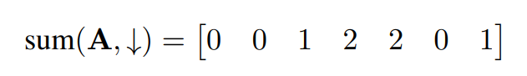
Greedy Algorithm
The sum for stage 2 is as follows:

Slide 13
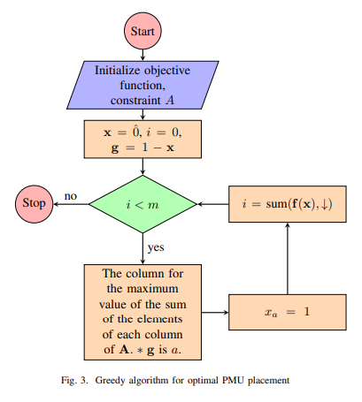
Greedy Algorithm
Flowchart

Slide 14
Octave glpk Function
The function glpk is used to solve Linear Programming (LP) problems of the type min c^{T} x subject to the linear constraints Ax = b where x ≥ 0 and its variations, namely, maximize instead of minimize, and inequality constraints or mixed constraints instead of equality constraints.

Slide 15
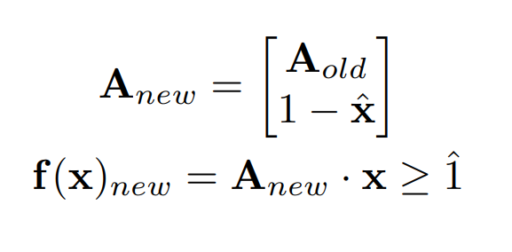
Optimal and Sub-optimal Solutions

Slide 16
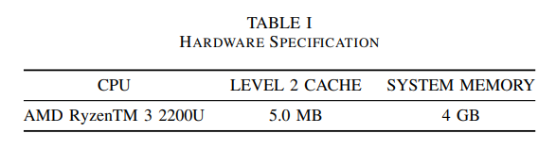
Hardware

Slide 17
SIMULATION RESULTS

Slide 18
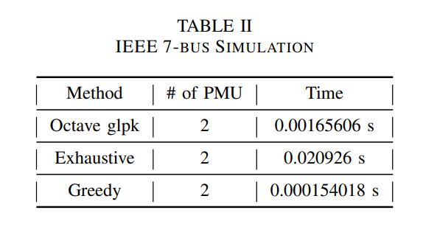
IEEE 7-bus Test System

Slide 19
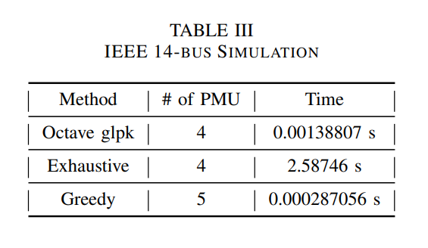
IEEE 14-bus Test System

Slide 20
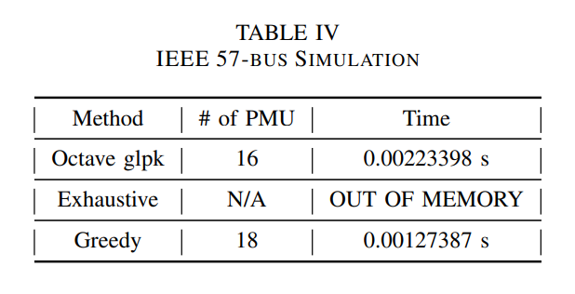
IEEE 57-bus Test System

Slide 21
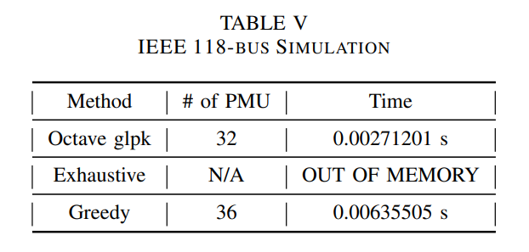
IEEE 118-bus Test System

Slide 22
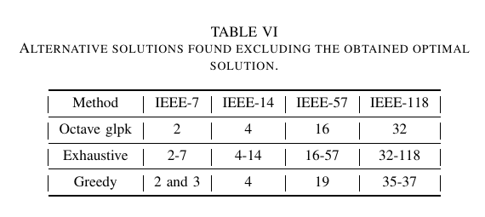
IEEE 7-bus other Optimal Simulation

Slide 23
Octave glpk vs MATLAB fmincon

Slide 24
Conclusion

Slide 25
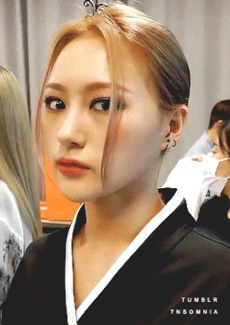
Thank You

